Slide 1
Project Presentation of Industry Oriented Hands on Experience (22CS422)
On
Artha AI
Ashish Karakoti 2210990186
Agam Garg 2210990077
Abhinav Savarni 2210990040
Akash 2210990081
Supervised By
Dr. Gifty Gupta
Department of Computer Science and Engineering,
Chitkara University, Punjab

Slide 2
Introduction
Financial management is an essential part of everyday life
However, most individuals lack structured tools to:
Track expenses
Plan savings
Make informed financial decisions
Existing systems are:
Fragmented
Limited in functionality
‹#›

Slide 3
Problem
Why ArthaAI?
People struggle with:
Expense tracking
Savings planning
Financial decisions
Existing apps:
Solve isolated problems
Lack intelligent insights
‹#›

Slide 4
Solution
ArthaAI provides :
Expense tracking
Goal planning
Financial analysis
AI-based recommendations
One platform for complete financial management
‹#›

Slide 5
Features
Core Features
💰 Expense Tracking
🎯 Goal Planning
📊 Analytics Dashboard
🧠 Smart Recommendations
👤 User Profiling
‹#›

Slide 6
System Architecture
Client (React)
↓
API (Express)
↓
Business Logic
↓
Recommendation Engine
↓
MongoDB
‹#›

Slide 7
Tech Stack
Frontend
React, Tailwind, Recharts
Backend
Node.js, Express
Database
MongoDB
Auth
JWT
‹#›

Slide 8
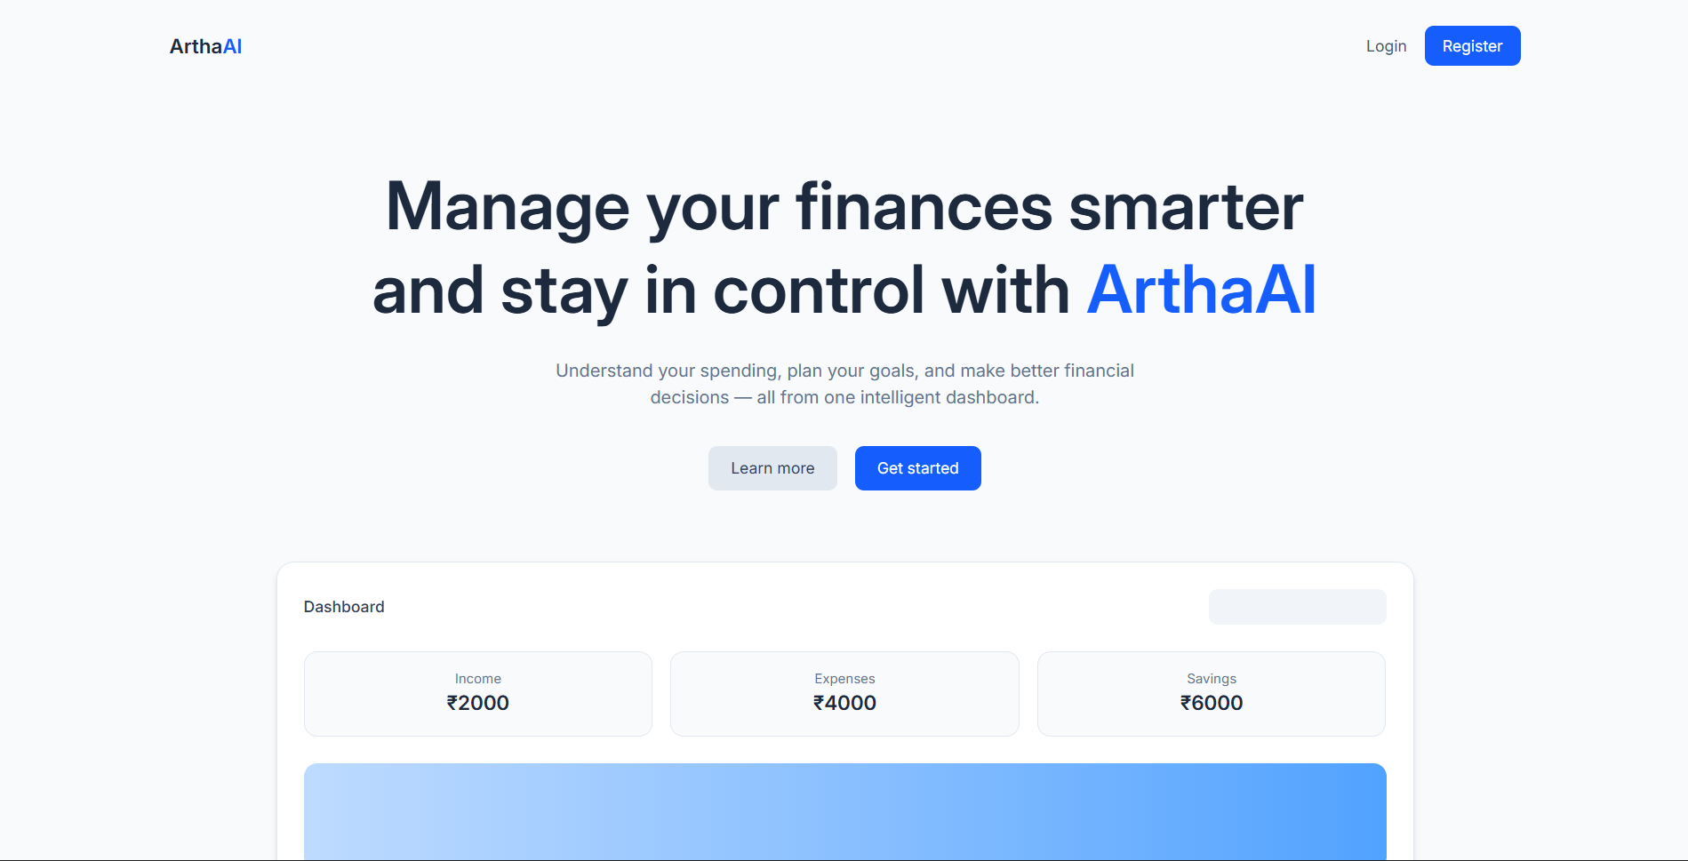
Screenshots
fig. Login Page
‹#›

Slide 9
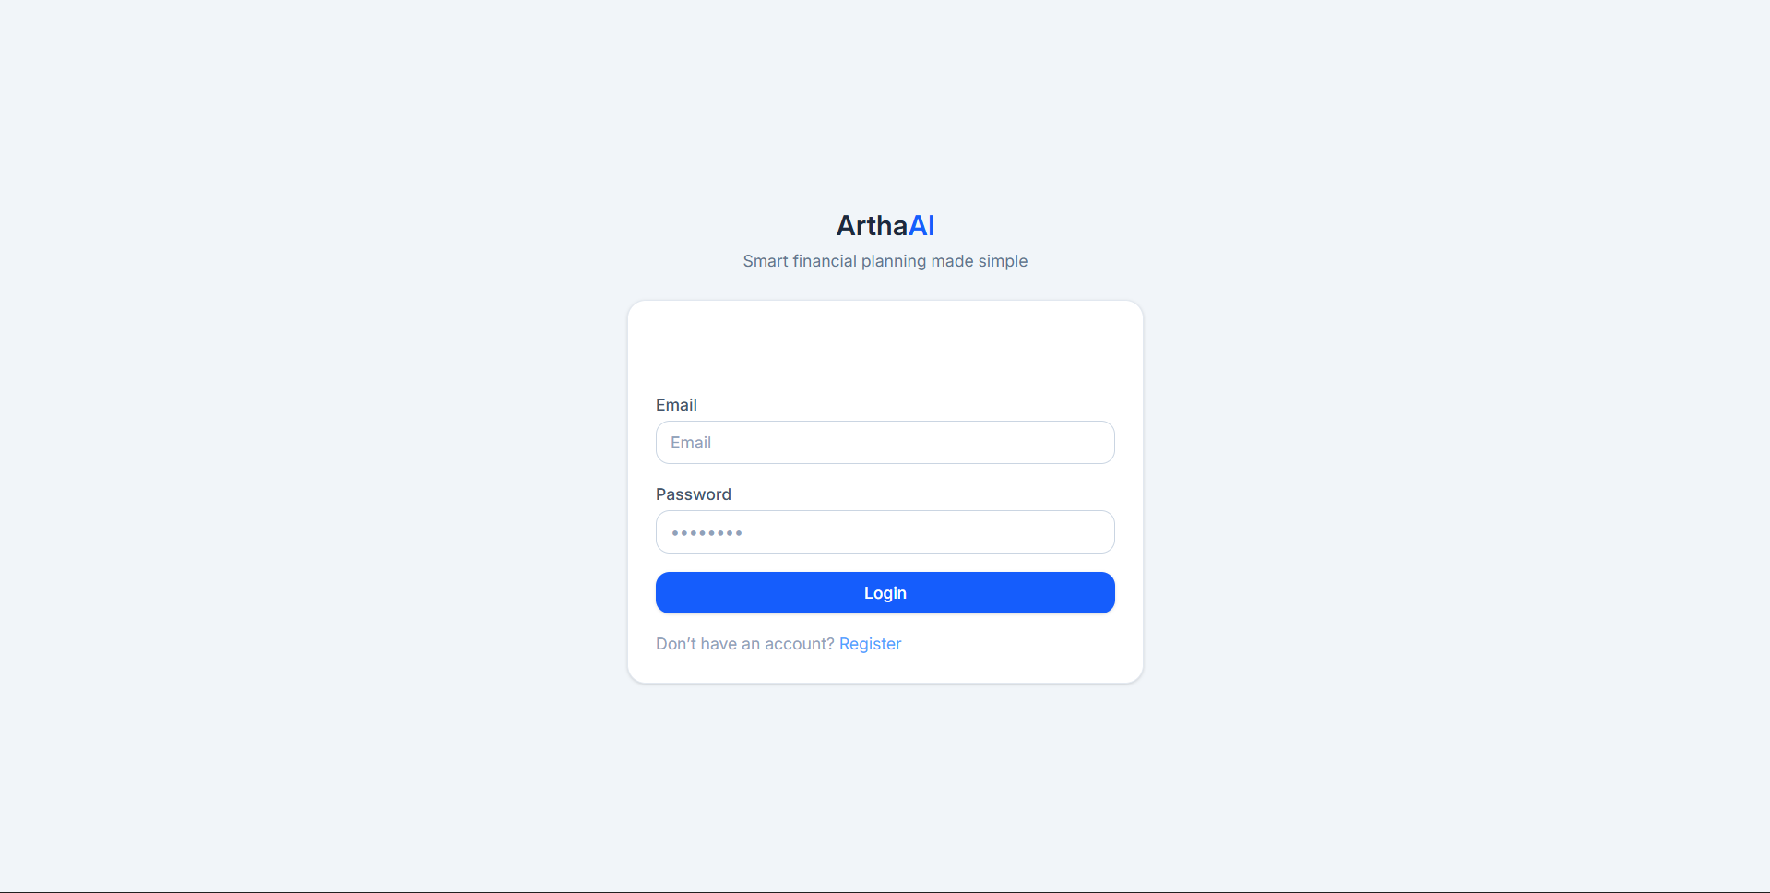
fig. Login Page
‹#›

Slide 10
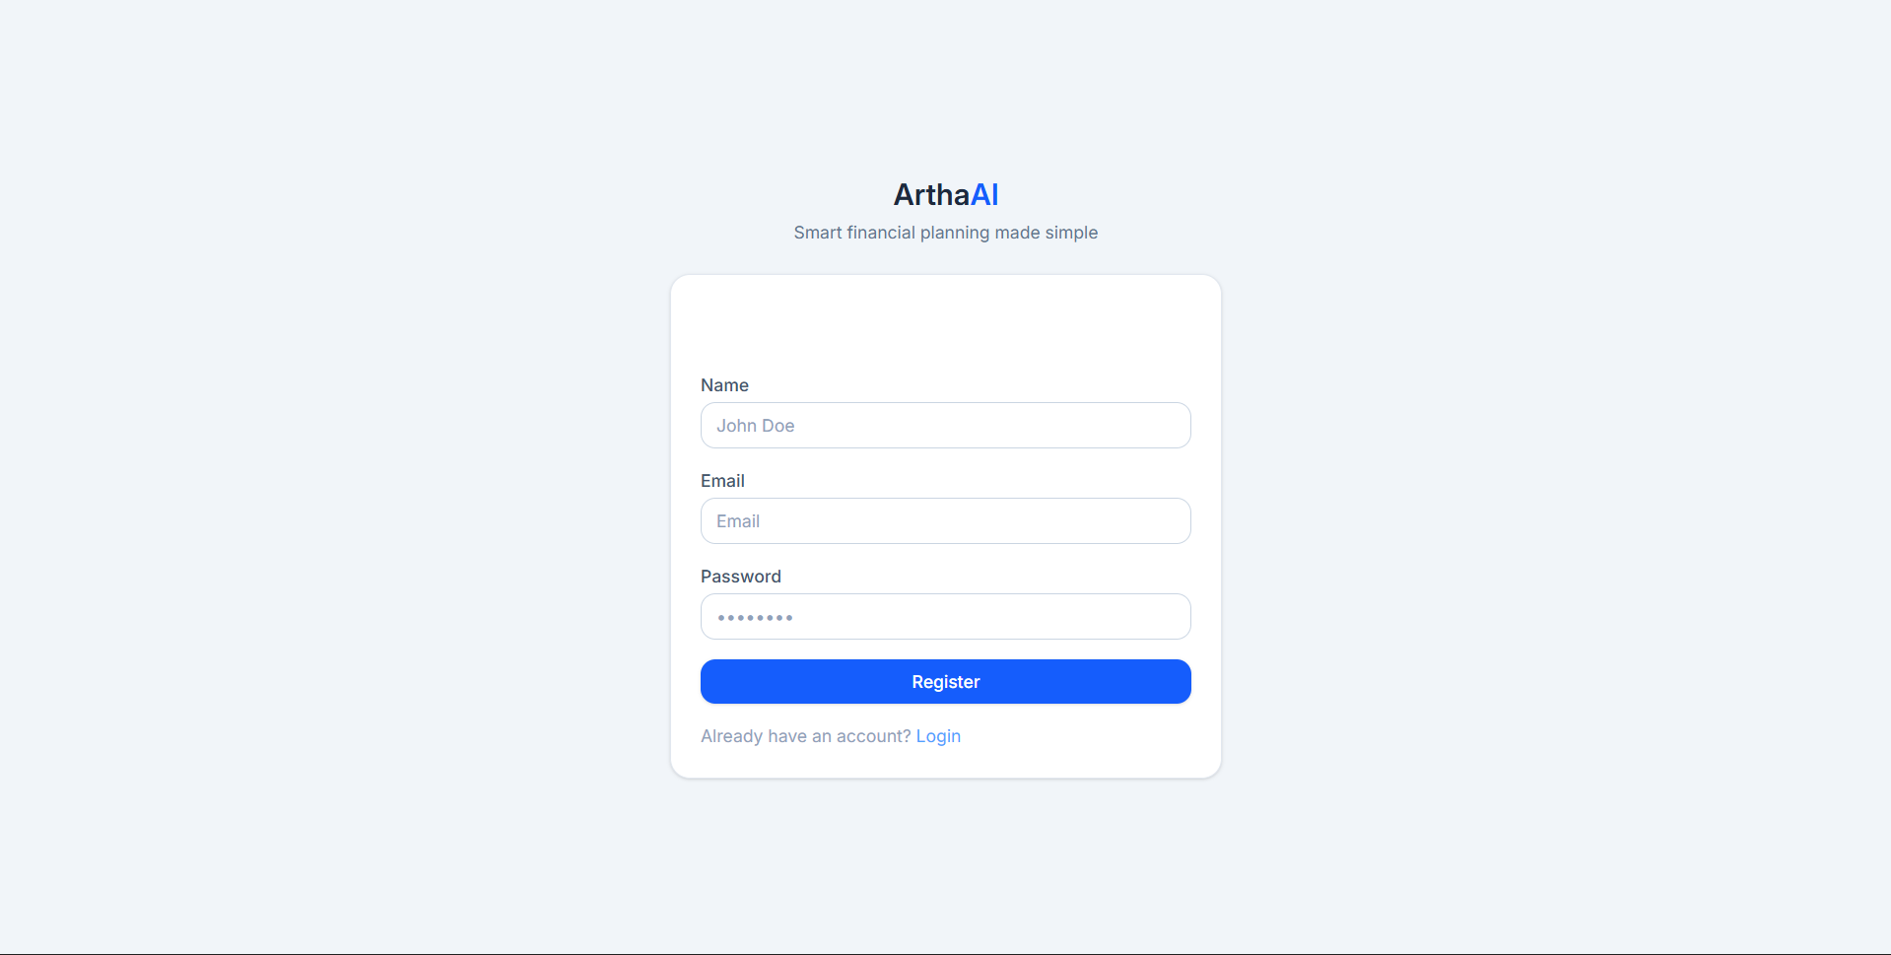
fig. Register Page
‹#›

Slide 11
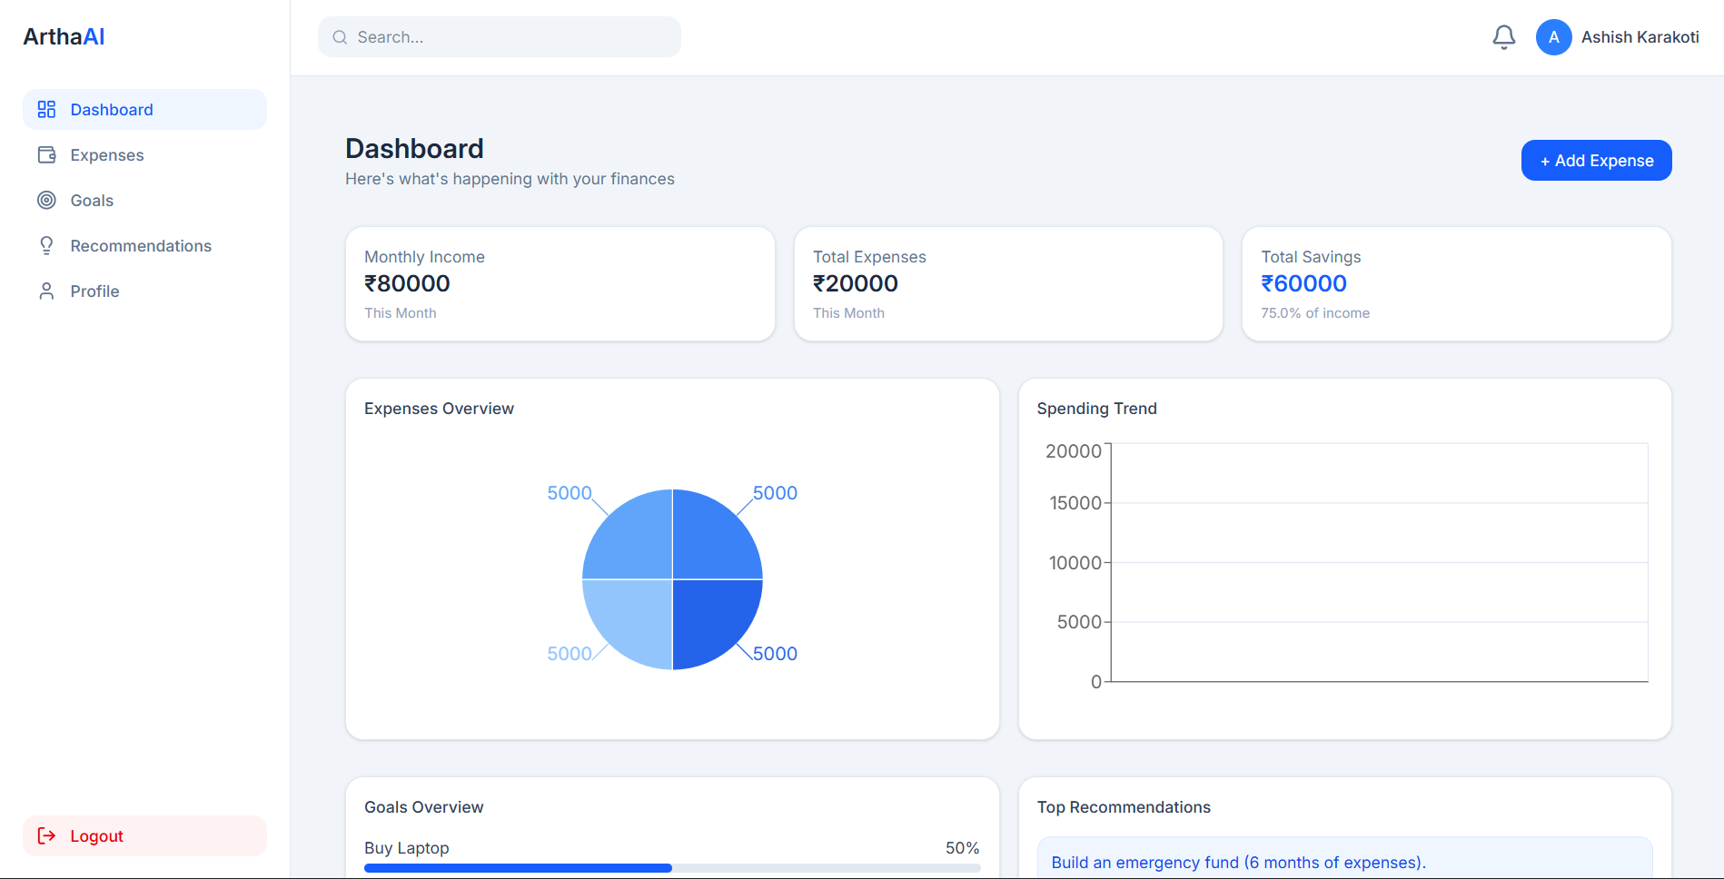
fig. Dashboard Page
‹#›

Slide 12
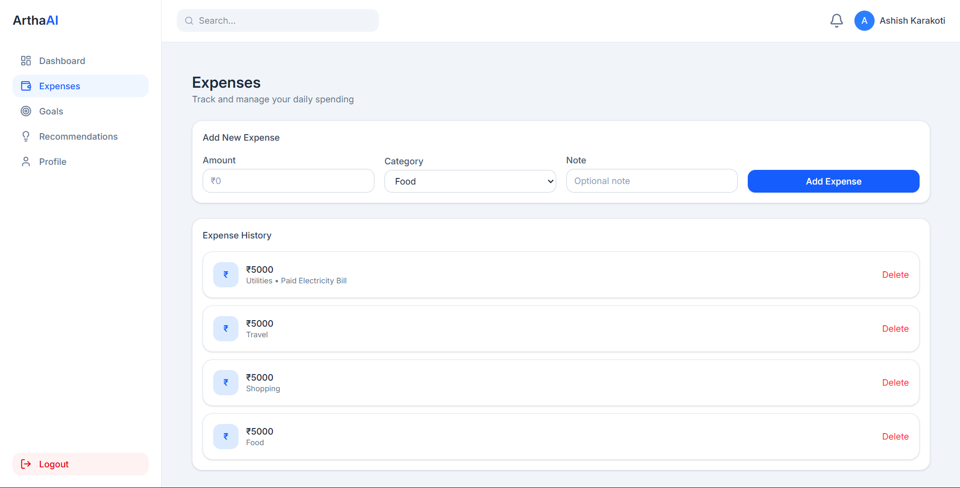
fig. Expenses Page
‹#›

Slide 13
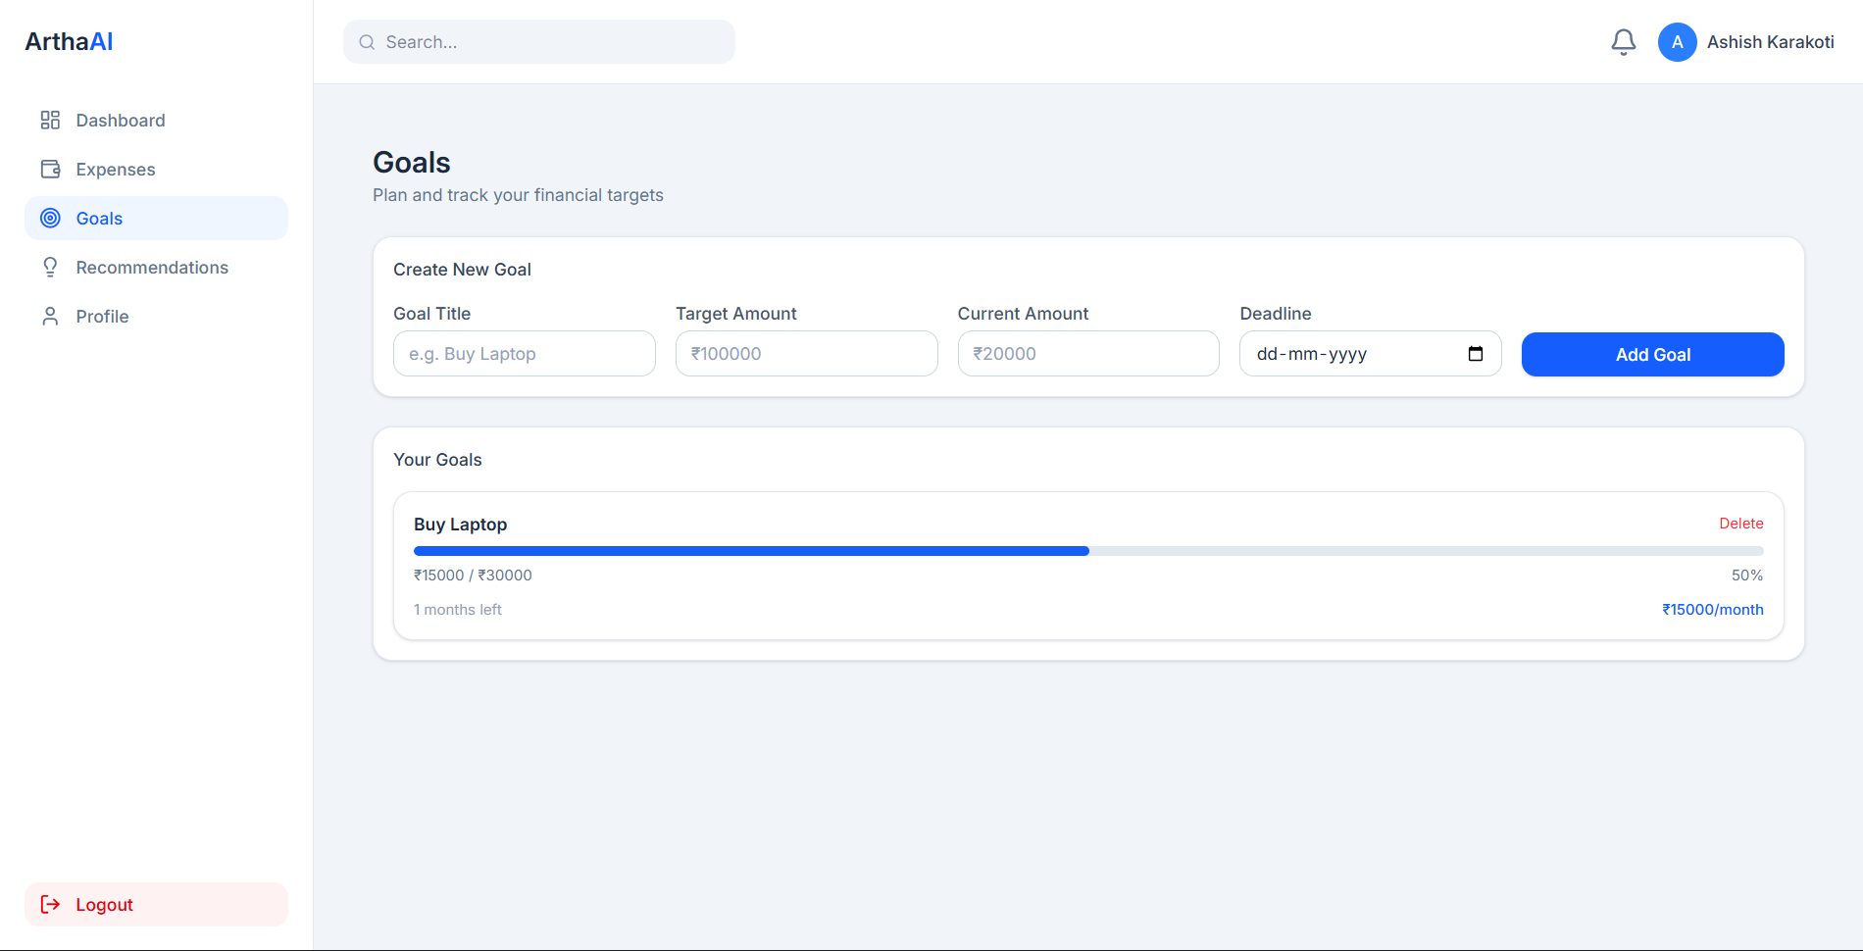
fig. Goals Page
‹#›

Slide 14
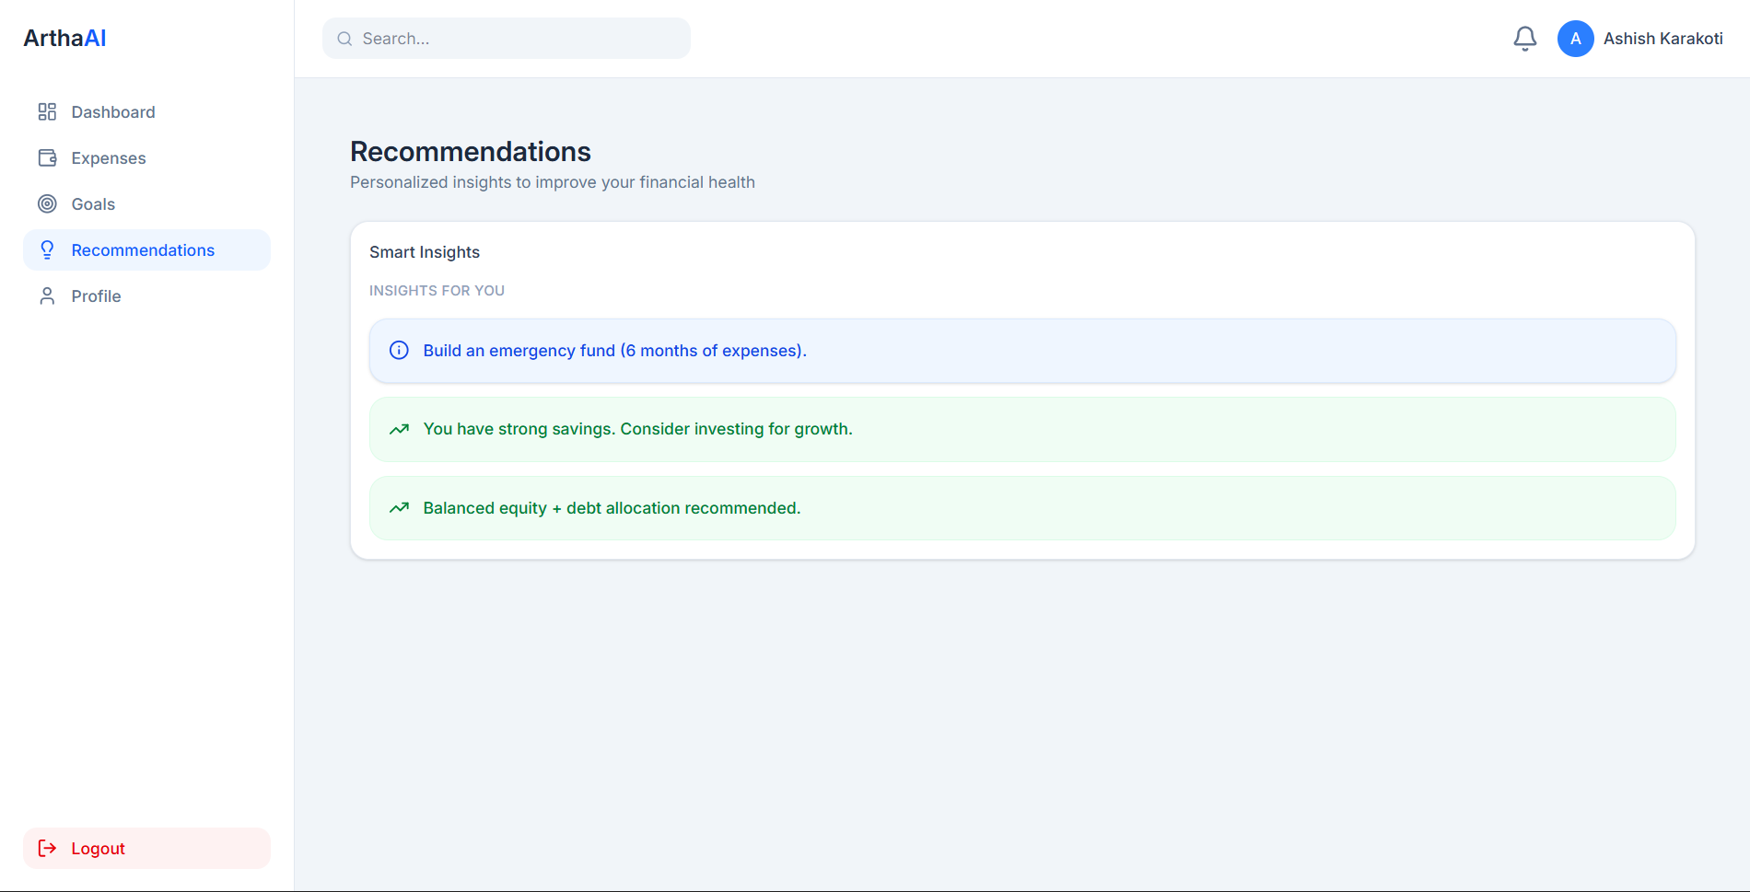
fig. Recommendations Page
‹#›

Slide 15
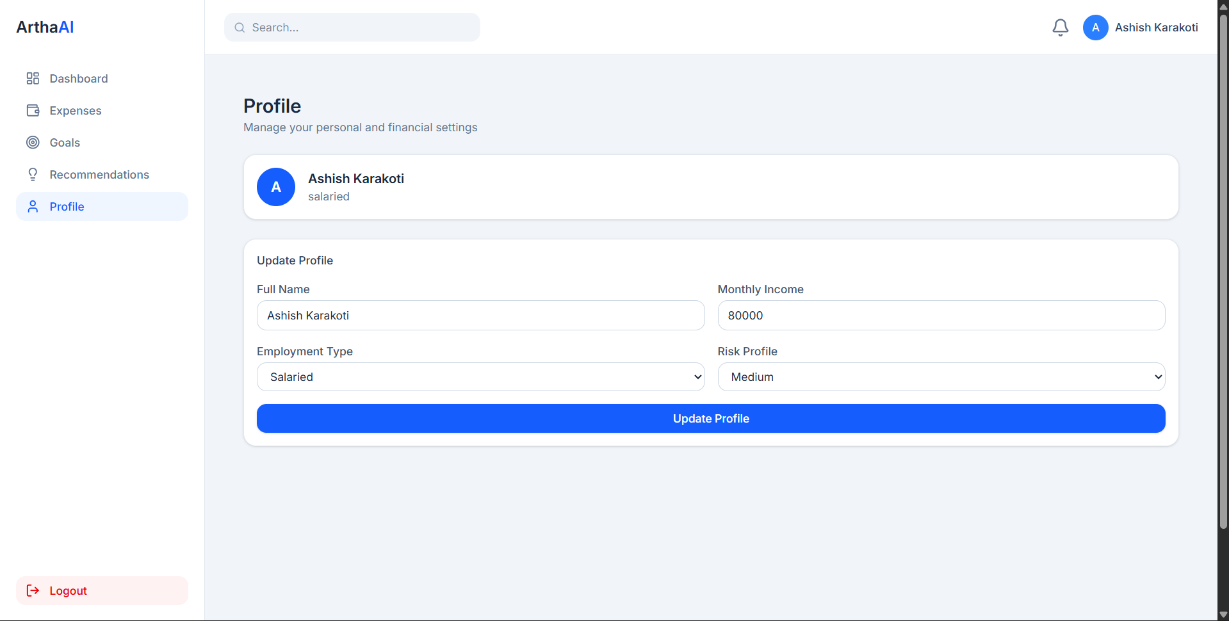
fig. Profile Page
‹#›

Slide 16
Conclusion
Improves financial awareness
Helps in smarter decision-making
Scalable full-stack system
‹#›

Slide 17
Thank You
‹#›

